Slide 1
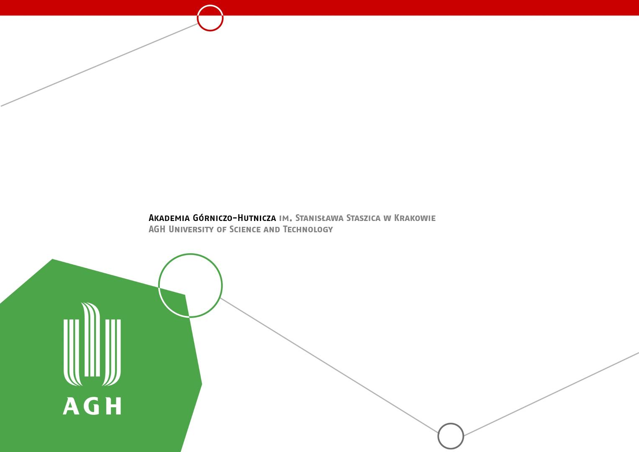
Agent Based Model of (Historical) Battle
Kseniia Sych
Bartłomiej Cerek
Vlad Leonov

Slide 2
Week | Tasks
28.10 - 03.11 | Research on Python libraries and tools for task.
04.11 - 10.11 | Development of proof-of-concept demos using different solutions.
11.11 - 17.11 | Choosing an approach. Design of environment representation and agent’s rules.
18.11 - 24.11 | Preparation of baseline code. Specification and implementation of agents interactions.
25.11 - 01.12 | Implementation of simulation mechanics.
02.12 - 08.12 | Creation of simple test models.
09.12 - 15.12 | Development of visualisation and analysis methods.
16.12 - 22.12 | Debugging and optimization. / Early evaluation and decision on next steps.
23.12 - 29.12 | Winter Break. Running simulation for relatively long time.
30.12 - 05.01 | Full modelling of selected event. / Analysis. / Research on additional functionality.
06.01 - 12.01 | Debugging and optimization. / Research on additional functionality.
13.01 - 17.01 | Deployment, wrap up, edit of documentation and preparation of final presentation.

Slide 3
Project Structure
ABMbattle
Engine
Strategies
Visualization
Level Designer
Configurations
Implements all possible actions of agents and environment.
Performs simulations.
Implements different strategies as classes for universal usage.
Standard Viewer:
Module for precise visualization of small battles.
Big Viewer:
Module for visualization of big battles without showing details.
User friendly graphical designer allowing for fast modeling of complex battle scenarios.
Configurations of battles are stored in JSON files and can be reused.
Unit class defines which strategies and actions are allowed.

Slide 4
Agents Abilities
01
Do nothing
Unit ALWAYS have to execute some action
This one is performed when unit has no other choice
It can be selected for strategic purposes
02
Move
Change location of unit
Unit can move only by one field at time
Von Neumann neighbourhood
03
Attack (close range)
Reduce HP of selected enemy, kill if <0
Only performed on direct neighbours
Attack is successful only with given probability
04
Attack (long range)
Same as close range but defender can be 2 fields away
Only specific units can fight long range
All long range units can also fight in close range
05
Block
Blocking give 80% of chances for stopping enemy attack
Block will work only for 1 round after using
Block action has to be performed before attack to work

Slide 5

Strategies
01
Random
Checks all possible actions and select random one
Used as benchmark
02
Kill The Closest
Finds closest enemy and tries to minimize Manhattan distance to it, when possible - attacks
Uses Breadth First Search
Computationally Costly
03
Pacifist
Reversed version of Kill The Closest
Maximises Manhattan distance
Simulates retreating enemy
04
Spartan
Keep one position - do not move
Front units try to block, those in the back attack
Requires some level of cooperation and good environment

Slide 6
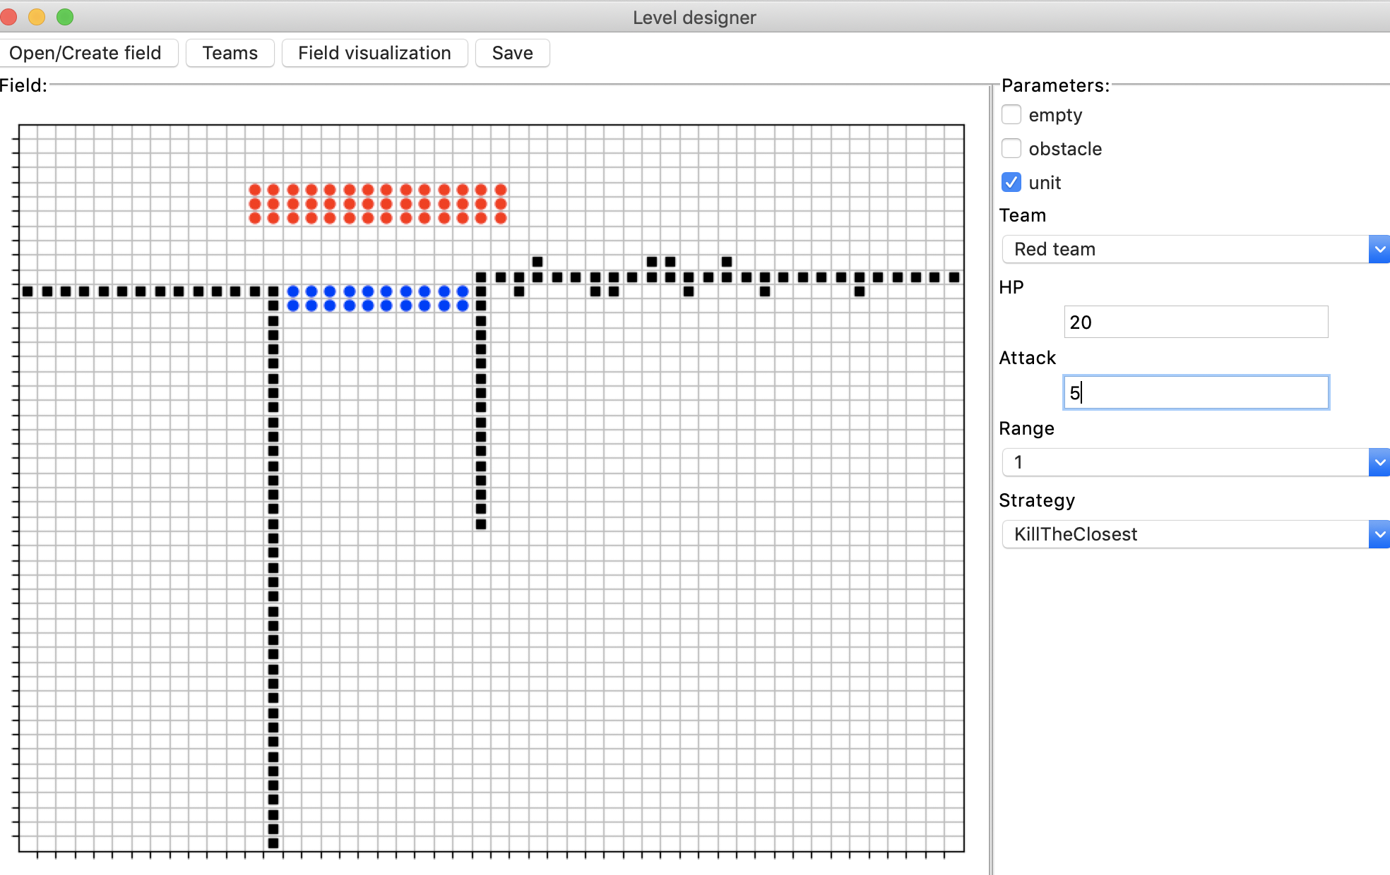
Level designer

Slide 7
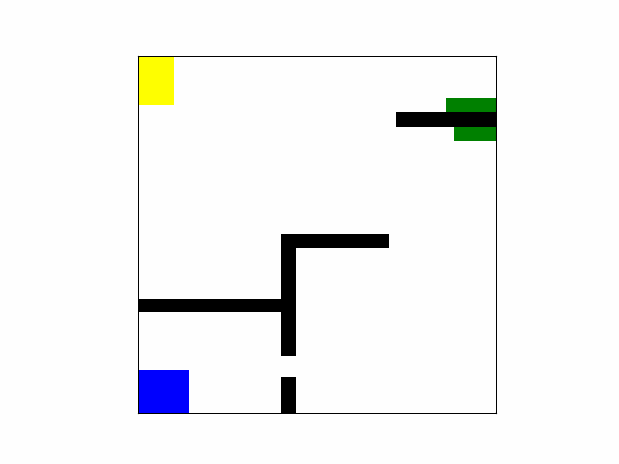
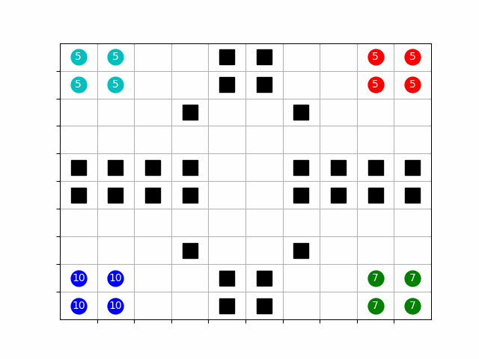
Visualizations

Slide 8
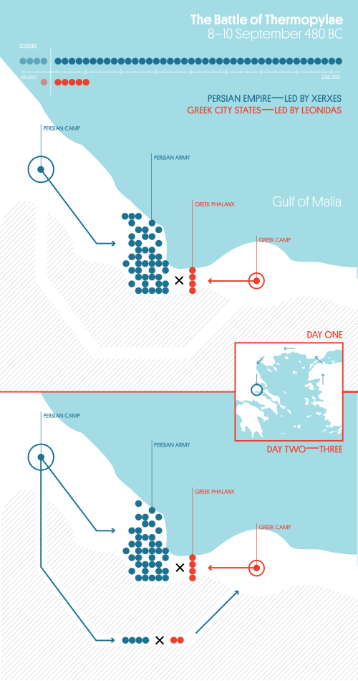
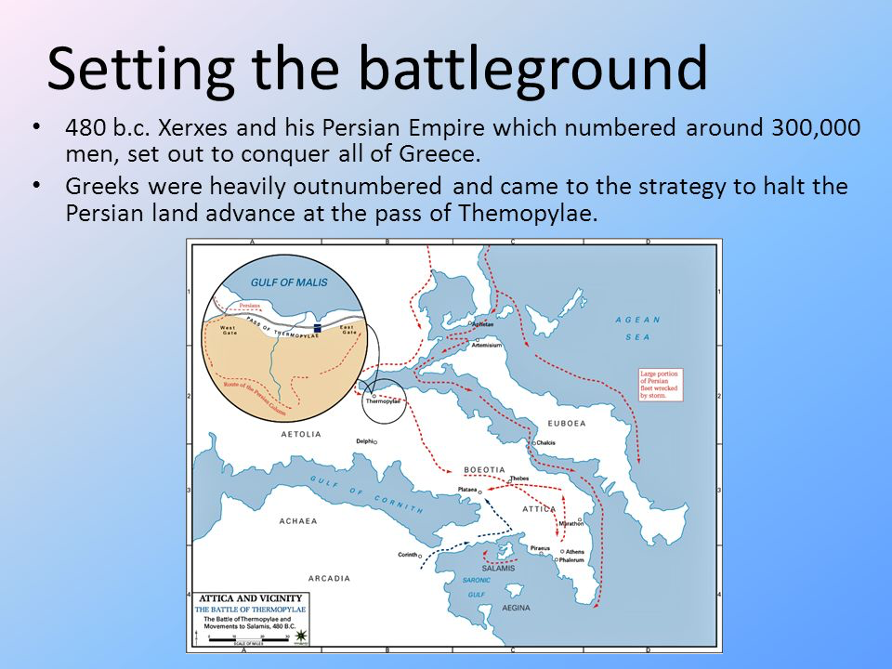
Final Simulation

Slide 9
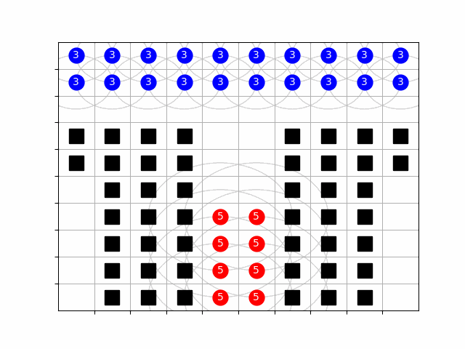
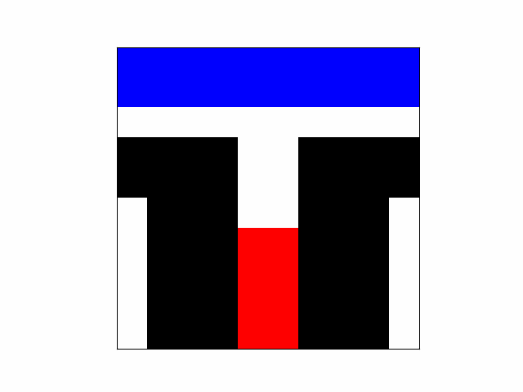
Simple 10x10 proof of concept

Slide 10
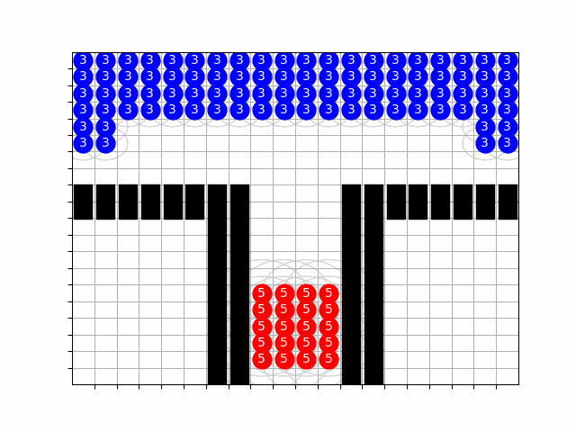
20x20 Persians win if they have strong
number advantage in simple environment

Slide 11
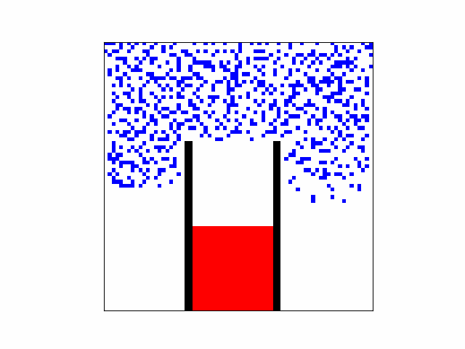
60x60 Ratio of Spartans to Persians is ½.
Strong win of Spartans.

Slide 12
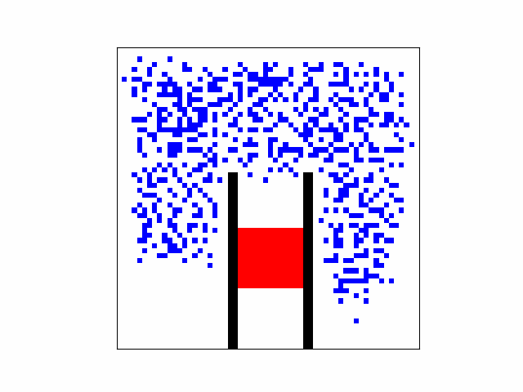
60x60 Ratio of Spartans to Persians is ¼.
Moderate win of spartans.

Slide 13
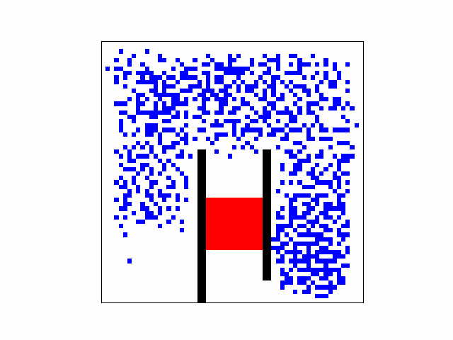
60x60 Ratio of Spartans to Persians is ⅕.
Treason scenario, loose of spartans.

Slide 14
Agent Based Model of (Historical) Battle
Kseniia Sych
Bartłomiej Cerek
Vlad Leonov

